Slide 1
Look up function

Slide 2

Camera Expectations

Slide 3



Before we start… Please have your camera switched on.
Camera Expectations
This is a mandatory requirement for the duration of the course.
You are studying a regulated qualification, your tutor needs to see that it is the right person participating throughout the course.
Our job is to prepare you for work in an age where in almost any job there is likely to be at least some aspect of remote engagement with your employer.
Online learning is to be treated the same way as a classroom learning, you must be physically visible to interact with your tutor and other learners in order to create an engaging group dynamic.

Slide 4
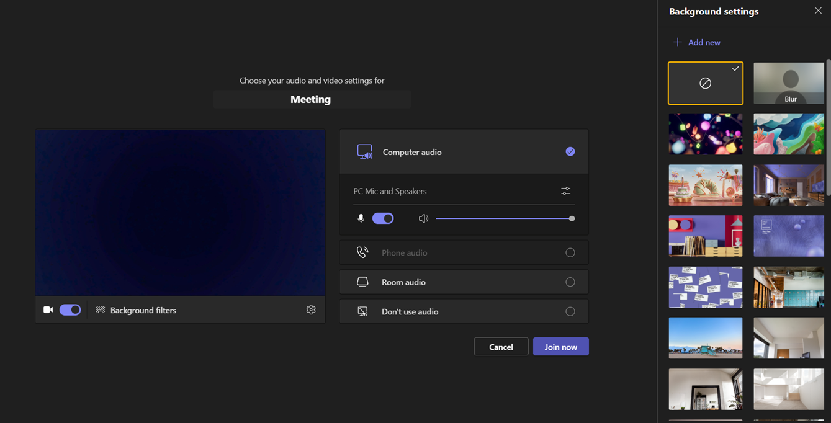
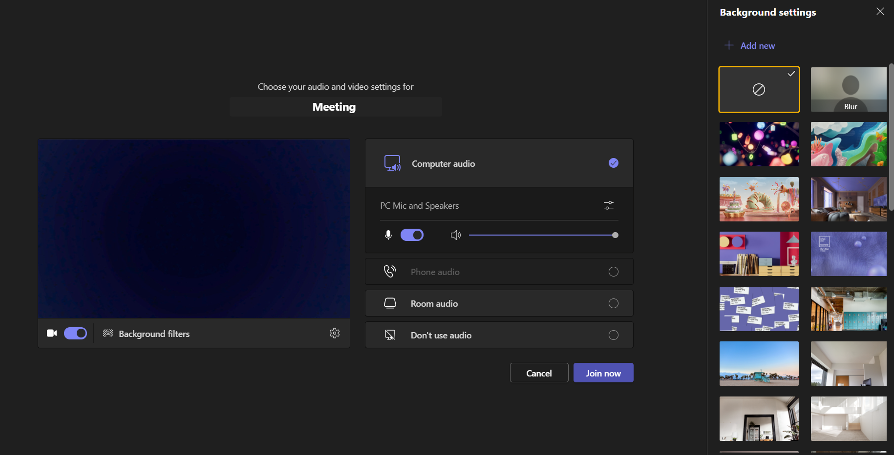
Background filters
If you do not wish to have your camera displaying your personal environment, Microsoft Teams has a solution to this problem…
Step One: Before you join a Teams video call, click the ‘Background Filters’ option.
Step Two: On the right-hand side, you can select any of the stock images.
Step Three: The image you choose will then appear in your background on the video call.
If you need any further support in regards to this requirement, please speak to your tutor directly.

Slide 5
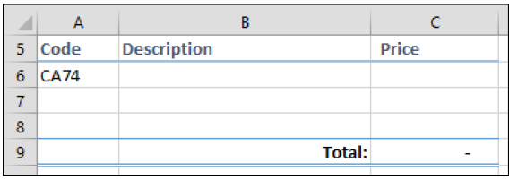
Use a VLOOKUP function for an exact lookup
Open Invoice-1 from your sample files folder
In this lesson, you will create a VLOOKUP formula that will automatically return the Description of any watch into column B when the user enters a stock code into column A
Notes:
When provided with a stock code, the VLOOKUP function can scan all of the codes in column A until a match is found and then return a value from the same row for any of the other columns.

Slide 6
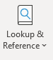
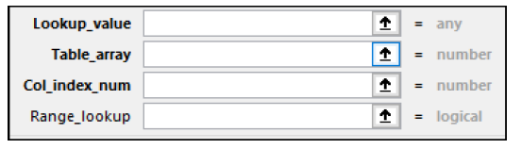
Insert a LOOKUP function into cell B6 on the Invoice worksheet to find the description that matches the Code in cell A6 on the Stock worksheet.
1. Click in cell B6 on the Invoice worksheet.
2. Click: Formulas→Function Library→ Lookup & Reference→VLOOKUP.
Notes:
Using a table will make the data dynamic. In other words, the VLOOKUP function will still work correctly if you add and remove rows from the Stock table.

Slide 7
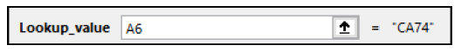
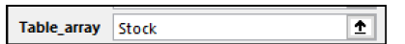
Set the Lookup_value argument to: A6
This is the cell on the Invoice worksheet that provides the value to be searched for in column A of the Stock table. You want to look up the description for the watch that has the code CA74. This is contained in cell A6.
Set the Table_array argument to: Stock
The table array is the range, table or name (see sidebar) you will search for a match to the value in cell A6. VLOOKUP always searches the left-most column of the range, table or name.
Type: Stock!A6:G15 into the Table_array text box

Slide 8
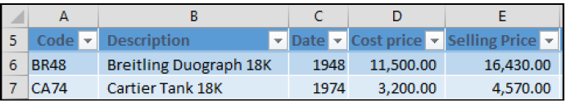
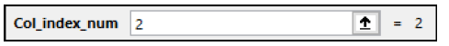
Set the Col_index_num argument to: 2
Counting from left to right, the Col_index_num argument is the column that contains the value you want to return. In this case, it is the Description column, so you want to return column 2.

Slide 9
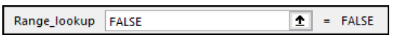
Set the Range_lookup argument to: FALSE
Beginners often overlook this vital argument because it is optional.
If it is left blank, VLOOKUP will return an inexact match. Later, in Lesson 3-25: Use a VLOOKUP function for an inexact lookup, you’ll find out why that might be useful, but in this case you want an error to be returned if the stock code is not found, so it is vital to set this argument to FALSE.
Click the OK button.
The description of the Cartier Tank 18K is returned to cell B6.
Save your work as Invoice-2

Slide 10
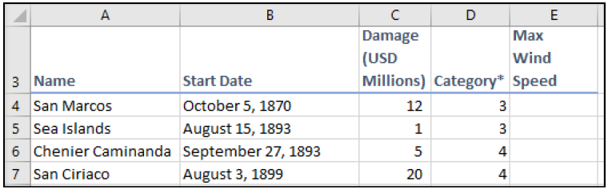
Use the SWITCH function
Open Biggest Atlantic Hurricanes-1 from your sample files folder.
The sample file for this lesson lists some of the biggest Atlantic hurricanes from 1870 to 2017. Each hurricane is categorized (from 1-5).
Notes:
In this lesson you will use the maximum wind speeds defined by the Saffir-Simpson Hurricane Wind Scale for category 1 to 5 hurricanes. The defined SSHS maximum wind speeds are extremely unlikely to change in the future, so it is reasonable to describe this as static data

Slide 11
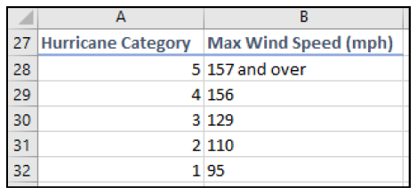
Use the SWITCH function to calculate the maximum wind speed for each hurricane.
The maximum wind speed for each hurricane category is shown at the bottom of the list:

Slide 12
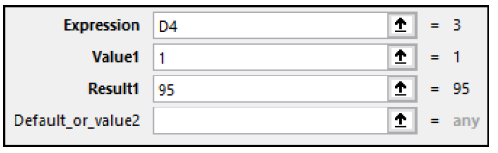
Click in cell E4.
2. Click: Formulas→Function Library→Logical→SWITCH.
The Function Arguments dialog appears.
3. Click in the Expression box.
4. Click once on cell D4.
5. In the Value1 box enter the value: 1
6. In the Result1 box enter the value: 95
You have now defined a Value/Result pair for a Category 1 hurricane.

Slide 13
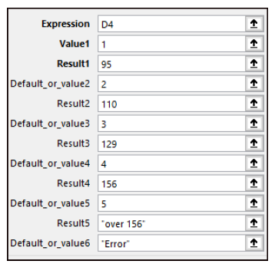
Continue to define pairs of values for category 2 to 5 hurricanes
The SWITCH function allows you to add up to 127 Value/Result pairs.
8. In the final Default_or_value6 box, type: “Error”
This text will be displayed in the event that a category cell is out of range or empty.
See sidebar for all of the values that you should
have entered.
9. Click the OK button.

Slide 14
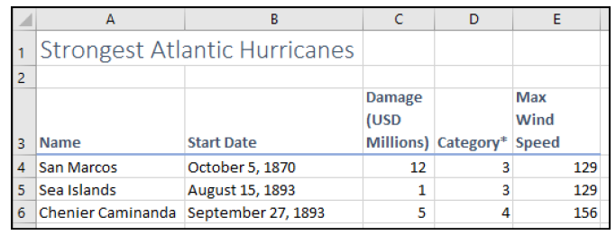
AutoFill the formula in cell E4 down to the end of the range.
The maximum wind speed is now shown for each hurricane.
Save your work as Biggest Atlantic Hurricanes-2.

Slide 15
Summative Assessment
Students are requested to complete the following short assessment to help us identify what they learned about the topic during the session. Note: This is a graded assessment.
Link to assessment: https://forms.office.com/Pages/ResponsePage.aspx?id=IA_9bshXR0S1PwDUmSylC9QnpiM2I7tDhSH-IzBN73pUQzJEU1VHS1pENzdJMTkzTTEzSTEzMVRKOC4u

